Slide 1
09 December
MOOC Wind energy
Midterm

Slide 2



Introduction

Slide 3
Contents
MOOC and wind energy
Wind energy concepts
The concept
The game
The learning aspect
The test plan
Conclusion

Slide 4
MOOC and wind energy
Open from teenagers to retirees
Expected play time of 30 minutes of unfocused time per day
Increase of retainment rate
Teach wind energy

Slide 5
Wind energy concepts
Several concepts of interest for this game:
Power loss over distance
Grid integration of wind turbines
Type of generator that can be used
The size of the blades
The effects of events
The wind effects on the output
The wind turbine placement

Slide 6
A tower defense game
The game is constructed around the tower defense concept.
No shooting, just pumping.
Wind turbines are used to power pumps.
The pumps are used to pump a flooding river.
A chapter based game with introduction of new mechanics each chapter.

Slide 7
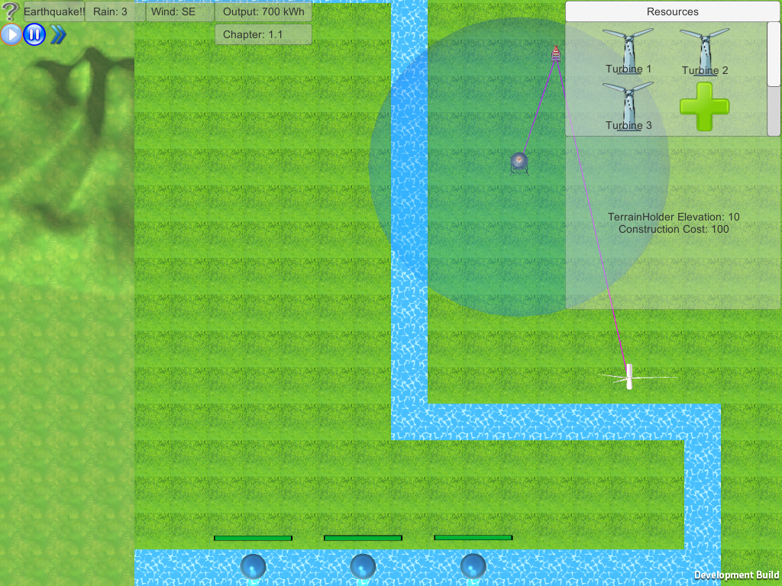

Slide 8
GAME TIME

Slide 9
Learning is the goal
The first playable is just a game.
The plan forward is a teaching game.
Visualizing the different learning objectives.
Wind turbine customization panel.
Feedback is key.
A chapter based game.

Slide 10
Testing plan
Test performed on people with little or no knowledge of wind turbines
Testing of the learning objectives
Step wise testing

Slide 11
Conclusion
Still a lot of work ahead
Will focus on the learning aspect of the game

Slide 12
?

